Slide 1
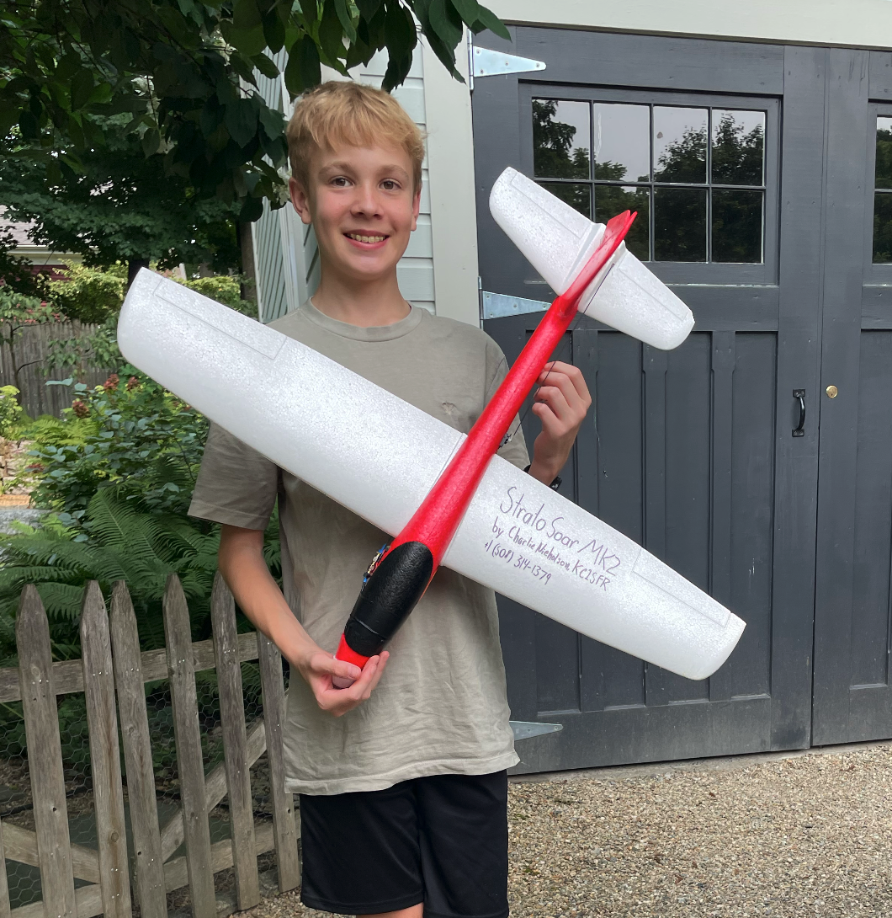
StratoSoar MK2
The High Altitude Glider
By Charlie Nicholson, KC1SFR
Notes:
I’m Charlie Nicholson, KC1SFR, and welcome to my presentation on StratoSoar MK2.

Slide 2
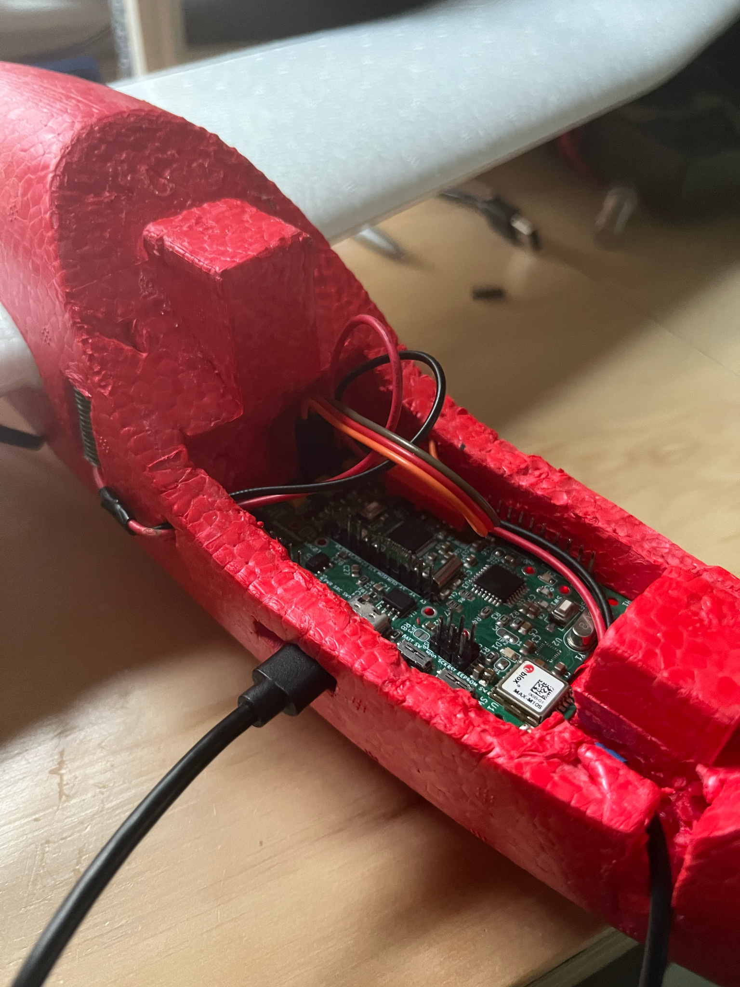
The Problem
Radiosondes pollute everyday
They drop circuit boards, batteries and foam
Notes:
Everyday, radiosondes get sent up to the atmosphere, twice a day from 92 stations in the US. The sondes cost $200 each, and 13.4 million dollars annually for the US. They get sent up to measure their data and never get used again, dropping circuit boards and foam which is harmful to the environment.

Slide 3
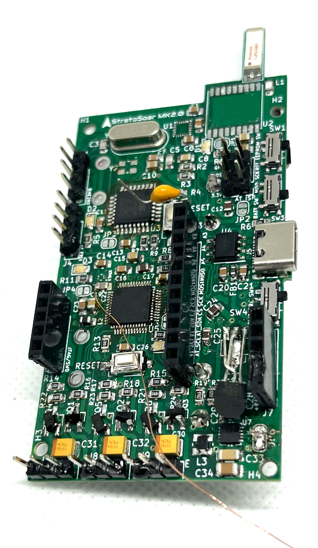
The Solution
A glider that can steer home for reuse
Glider has same sensors that a radiosonde would have + more
First revision of the circuit board.
Notes:
The solution I thought of was a reusable radiosonde in the form of an autonomous glider. This glider would have the same sensors as a radiosonde plus some more. The glider is brought up in a weather balloon and is dropped. It then fully autonomously steers back home or to specific areas that need weather forecasting. There are also some other applications, such as high altitude research and remote parcel delivery, to name a few.

Slide 4
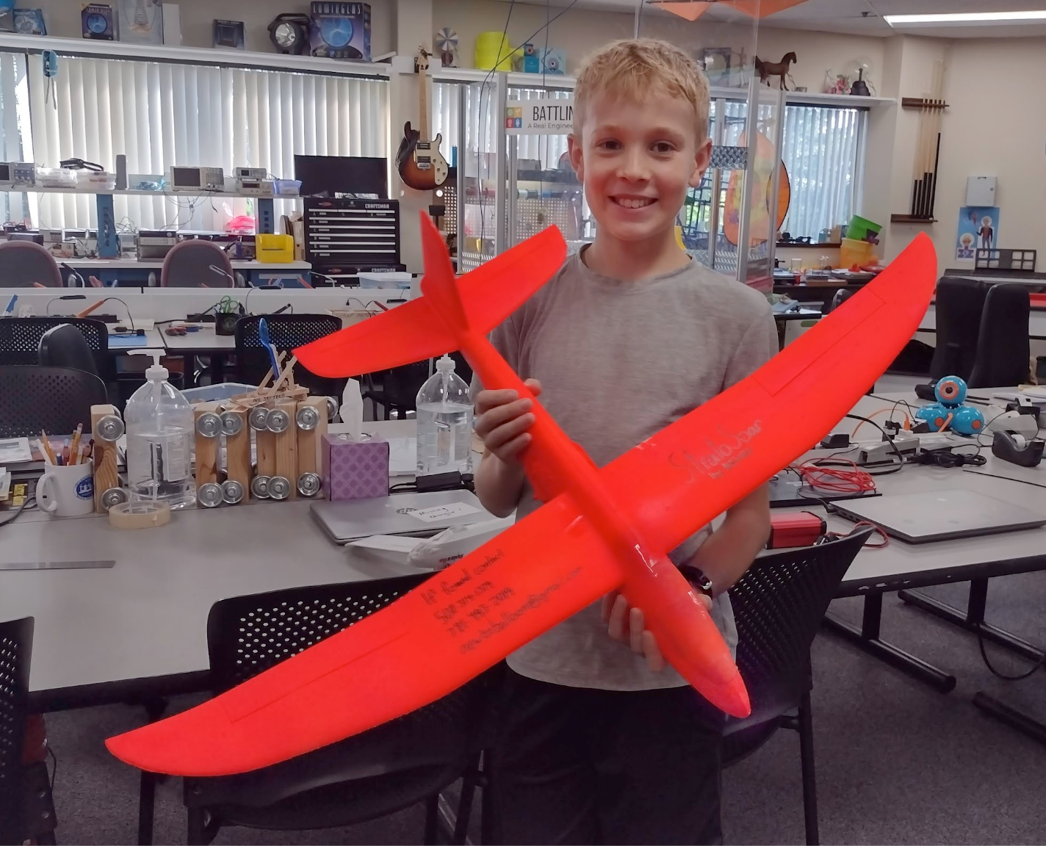
Past Work
Tried last year with StratoSoar MK1
Didn’t achieve autonomy or correct tracking
Notes:
Last year, I made a glider with the intent to fly without guidance, called StratoSoar MK1. However, both the cutdown mechanism and the tracker didn’t work, meaning that we didn’t get any high altitude flight data.

Slide 5
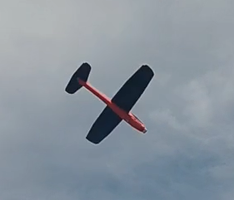
What I Did
Autonomous glider
Custom flight computer PCB
Launch from 5,000 feet
Tiny4FSK tracking system, designed by Max Kendall W0MXX
Notes:
This year, I made an actual autonomous glider that can orient itself to the correct heading. I designed a custom flight computer to tie everything together, and did a launch from 5,000 feet. Lastly, I used the Tiny4FSK tracking system to track the glider.

Slide 6
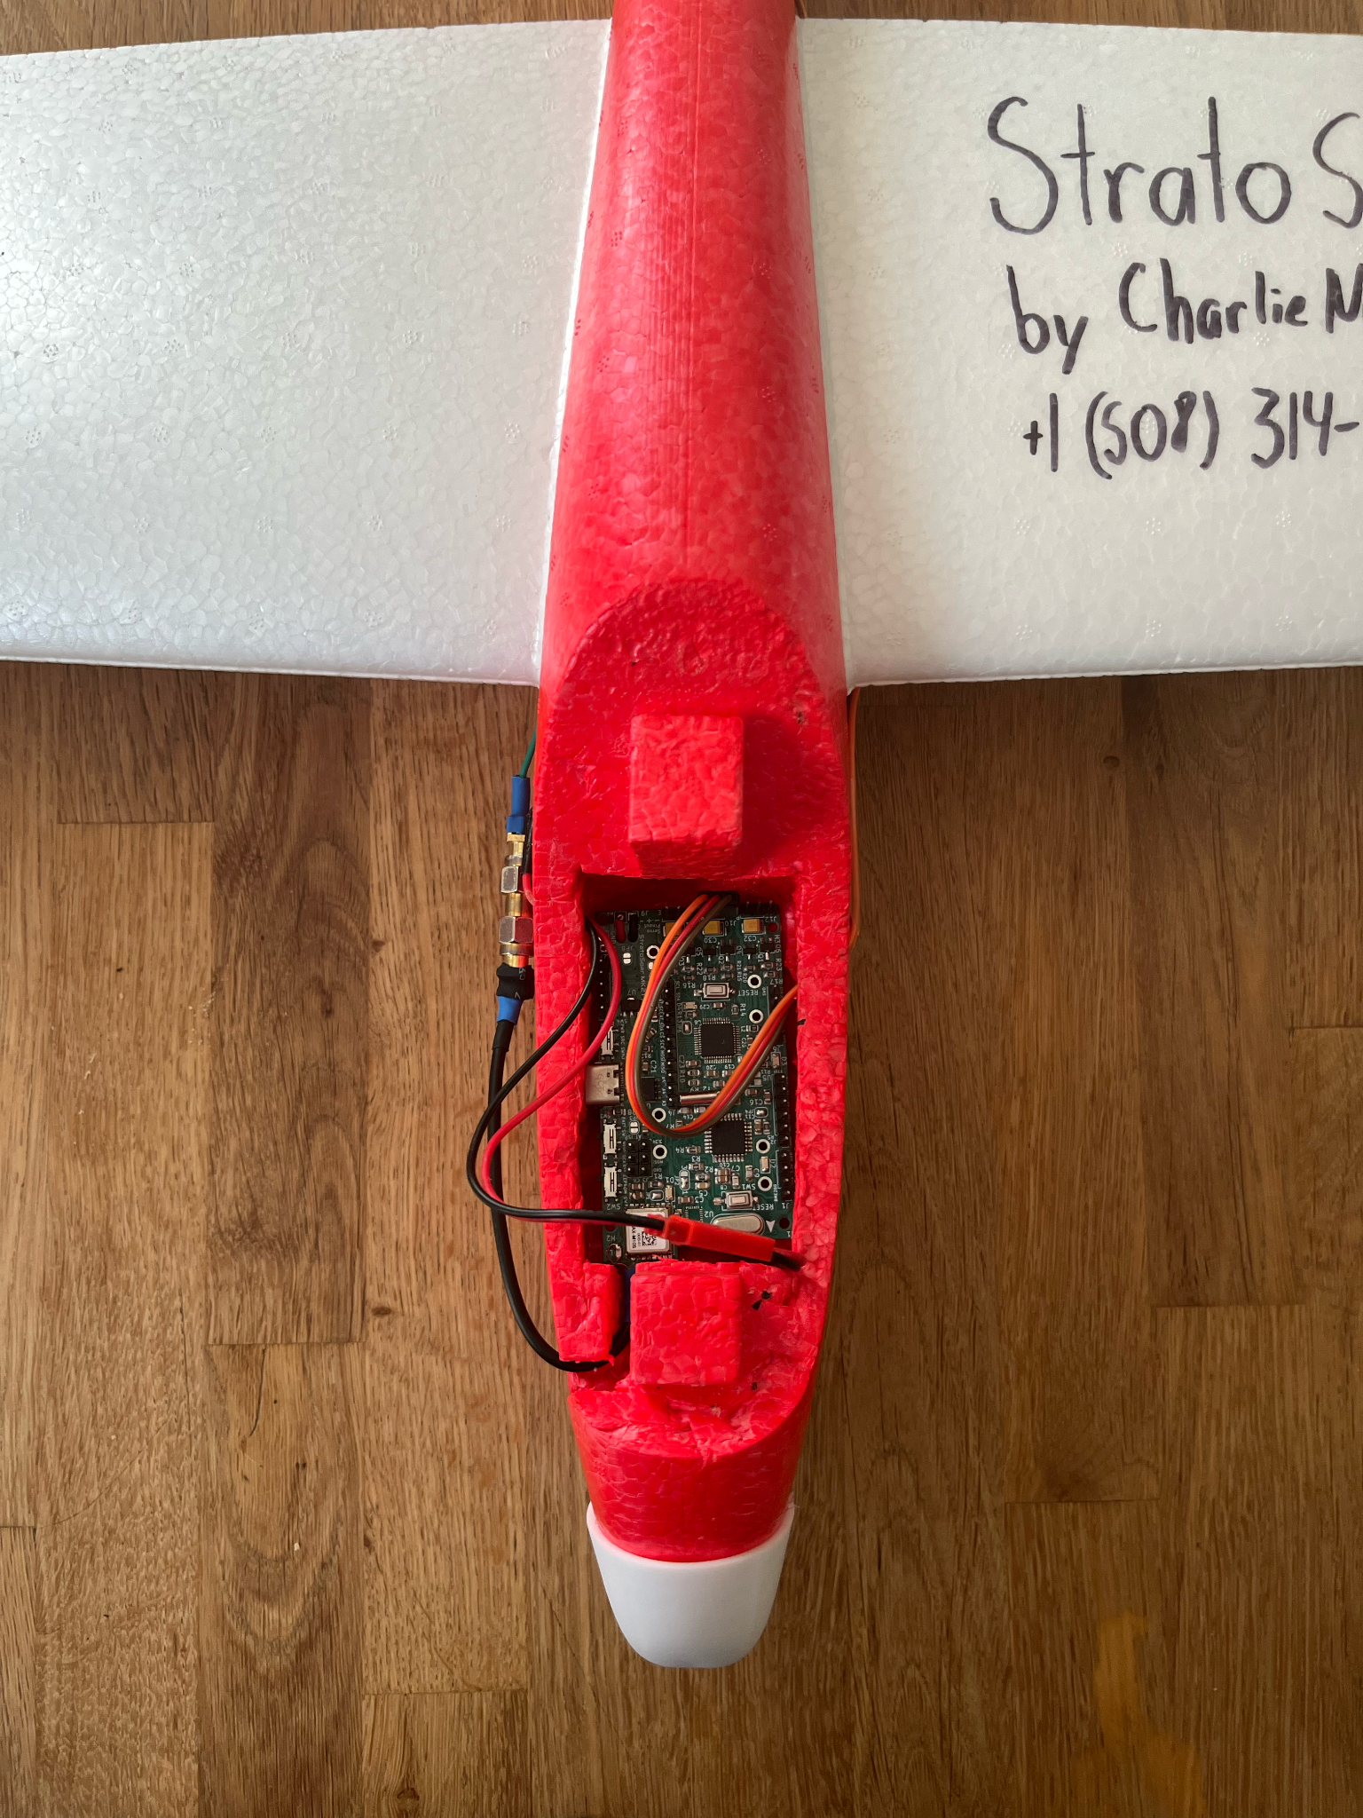
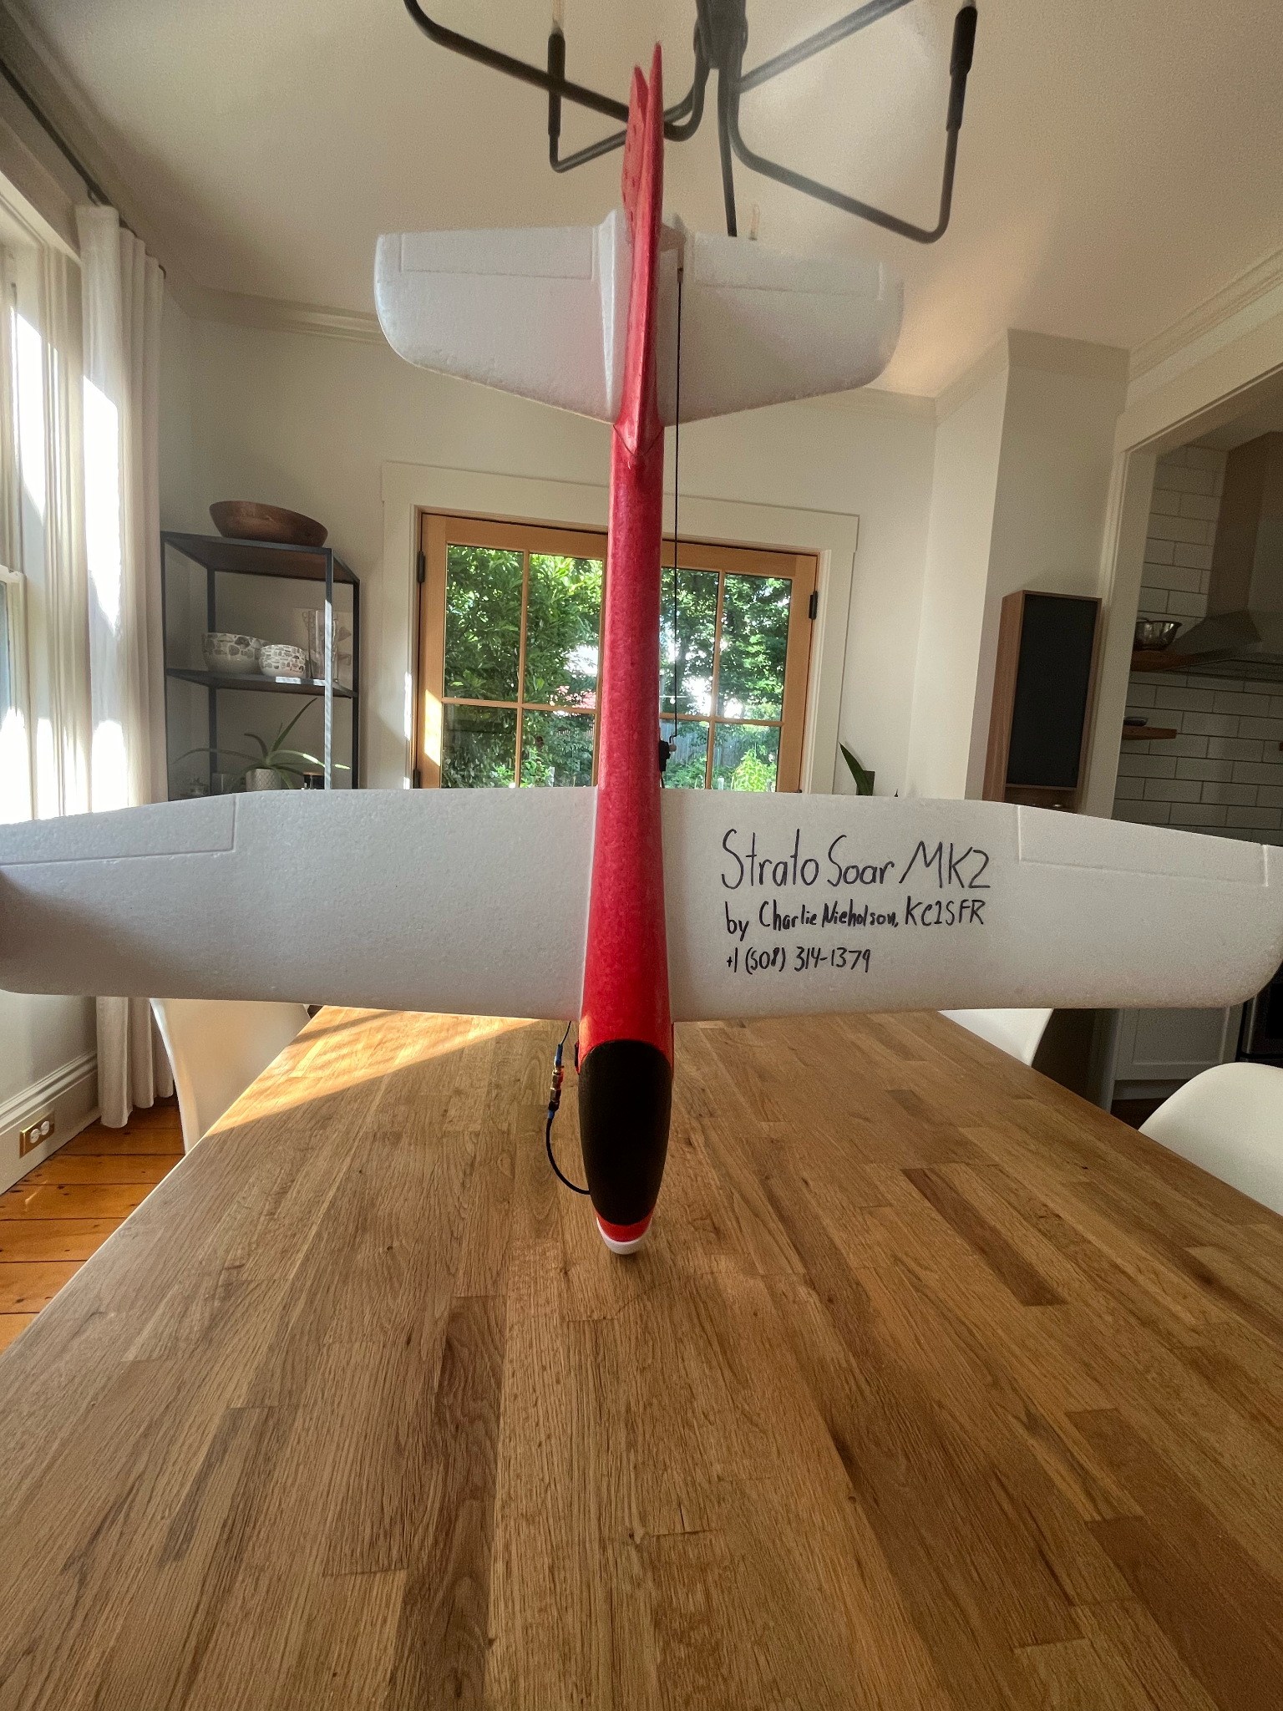
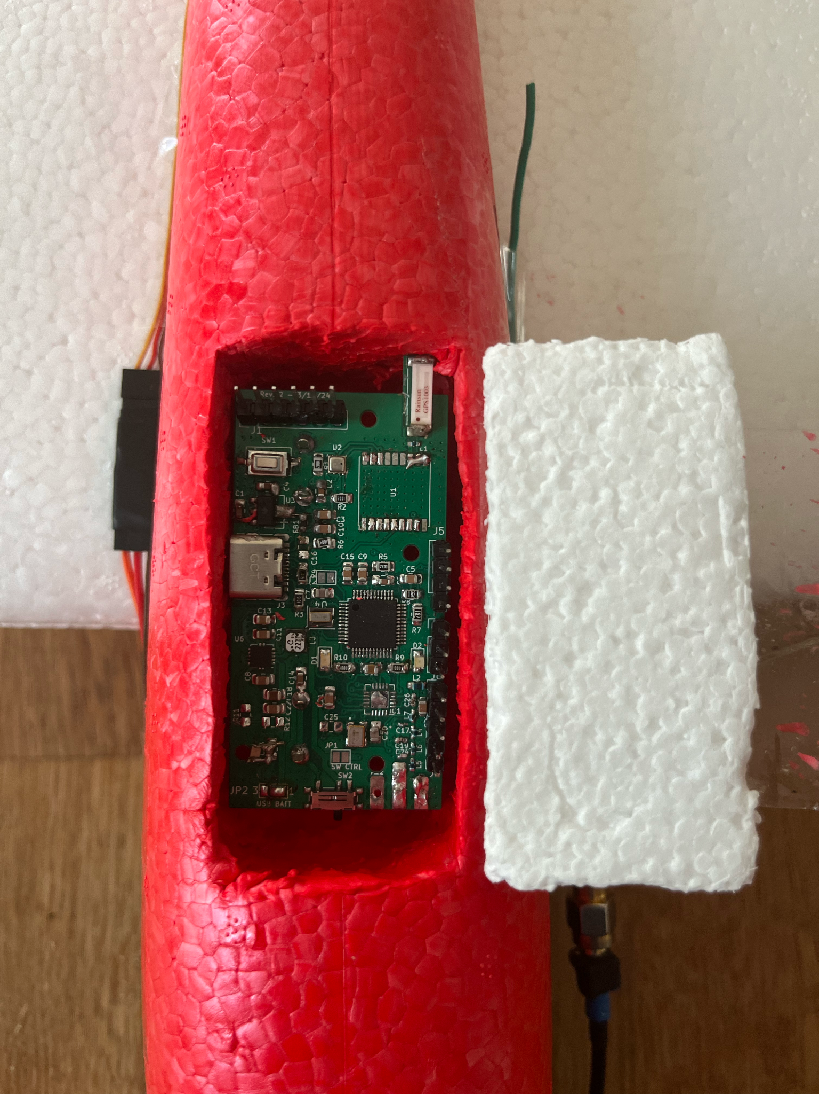
The Glider
Store bought foam glider
Cockpit rigged to hold custom PCB
Rudder modified for servo
Bay for tracker
Notes:
For the actual glider, we bought an 80 cm wingspan foam glider off Amazon. We used a hot foam cutter to carve out a space in the cockpit for the electronics, and another space was carved out for the tracker. We also fitted a custom nose guard and antenna mounts.

Slide 7
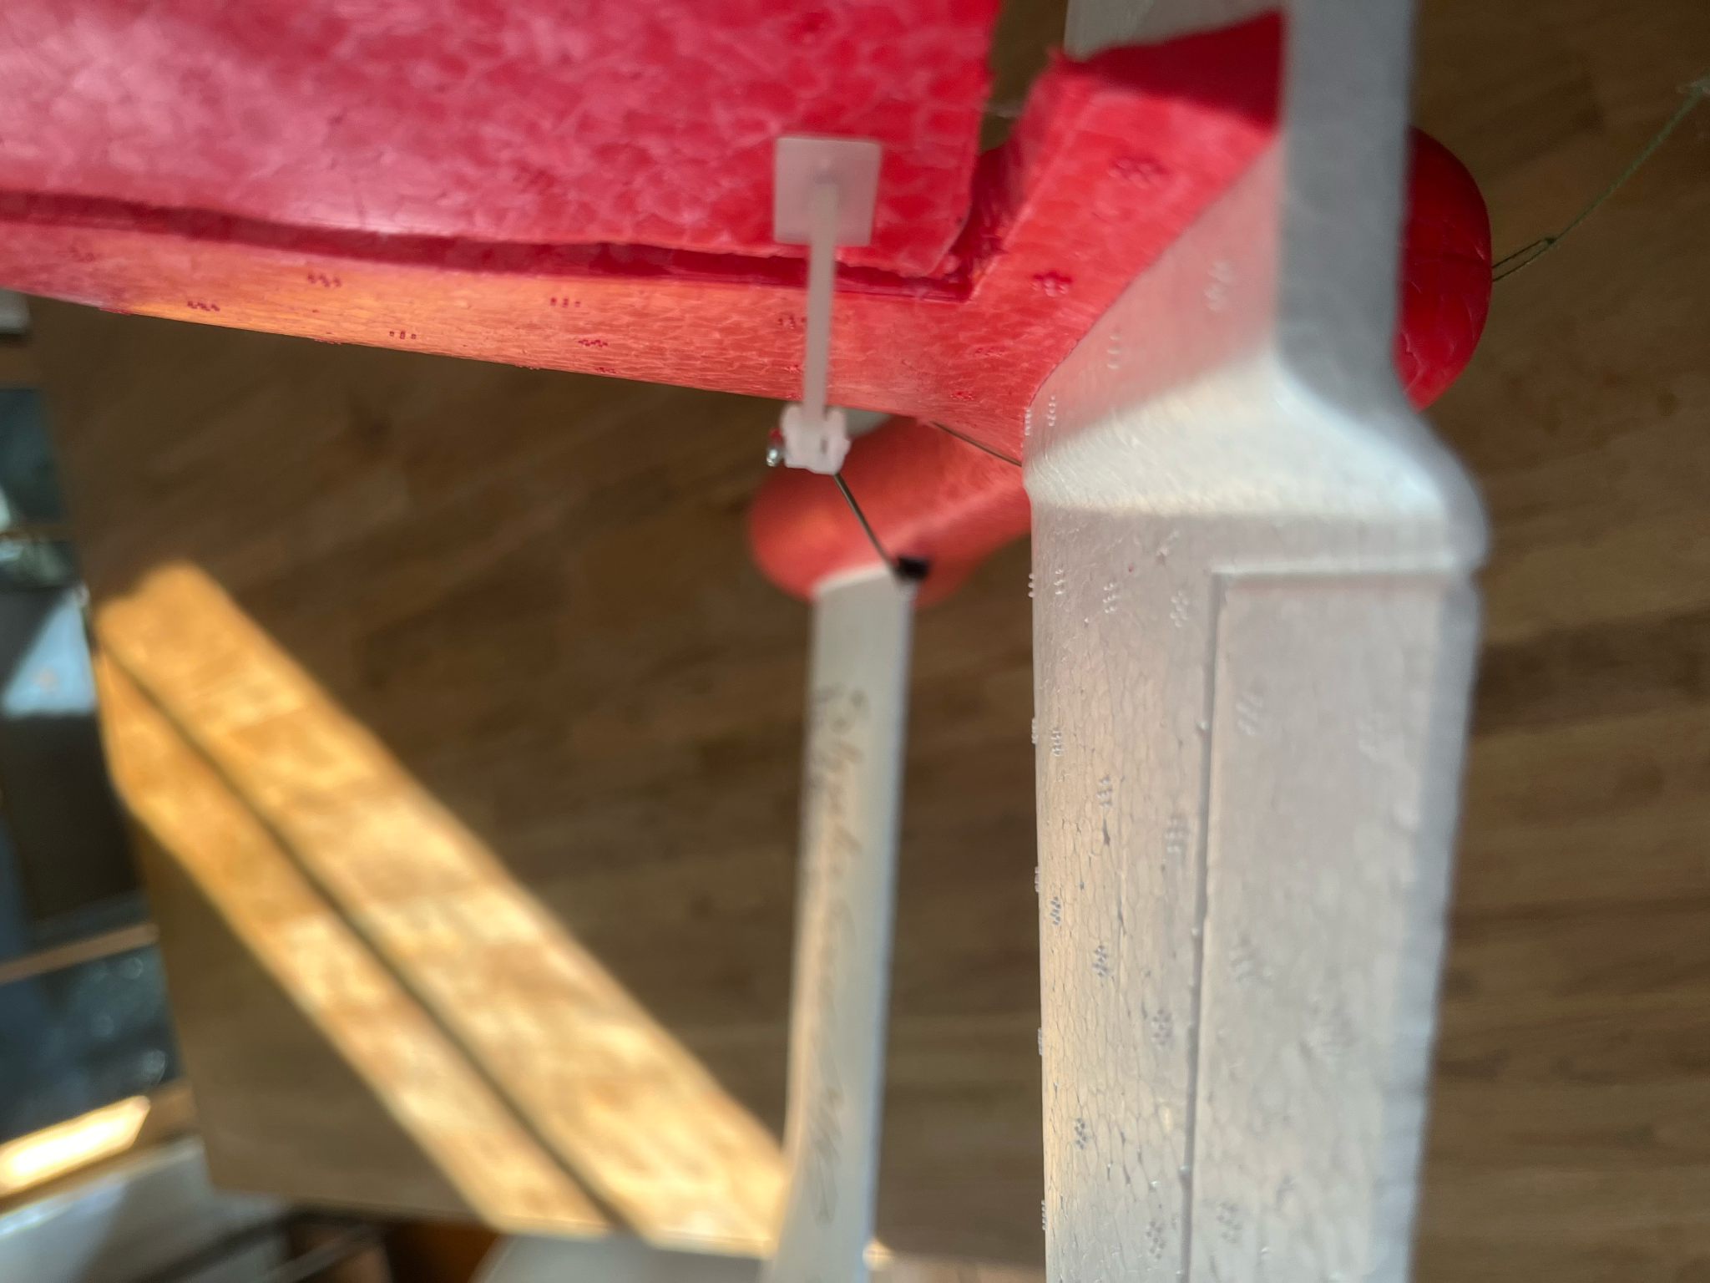
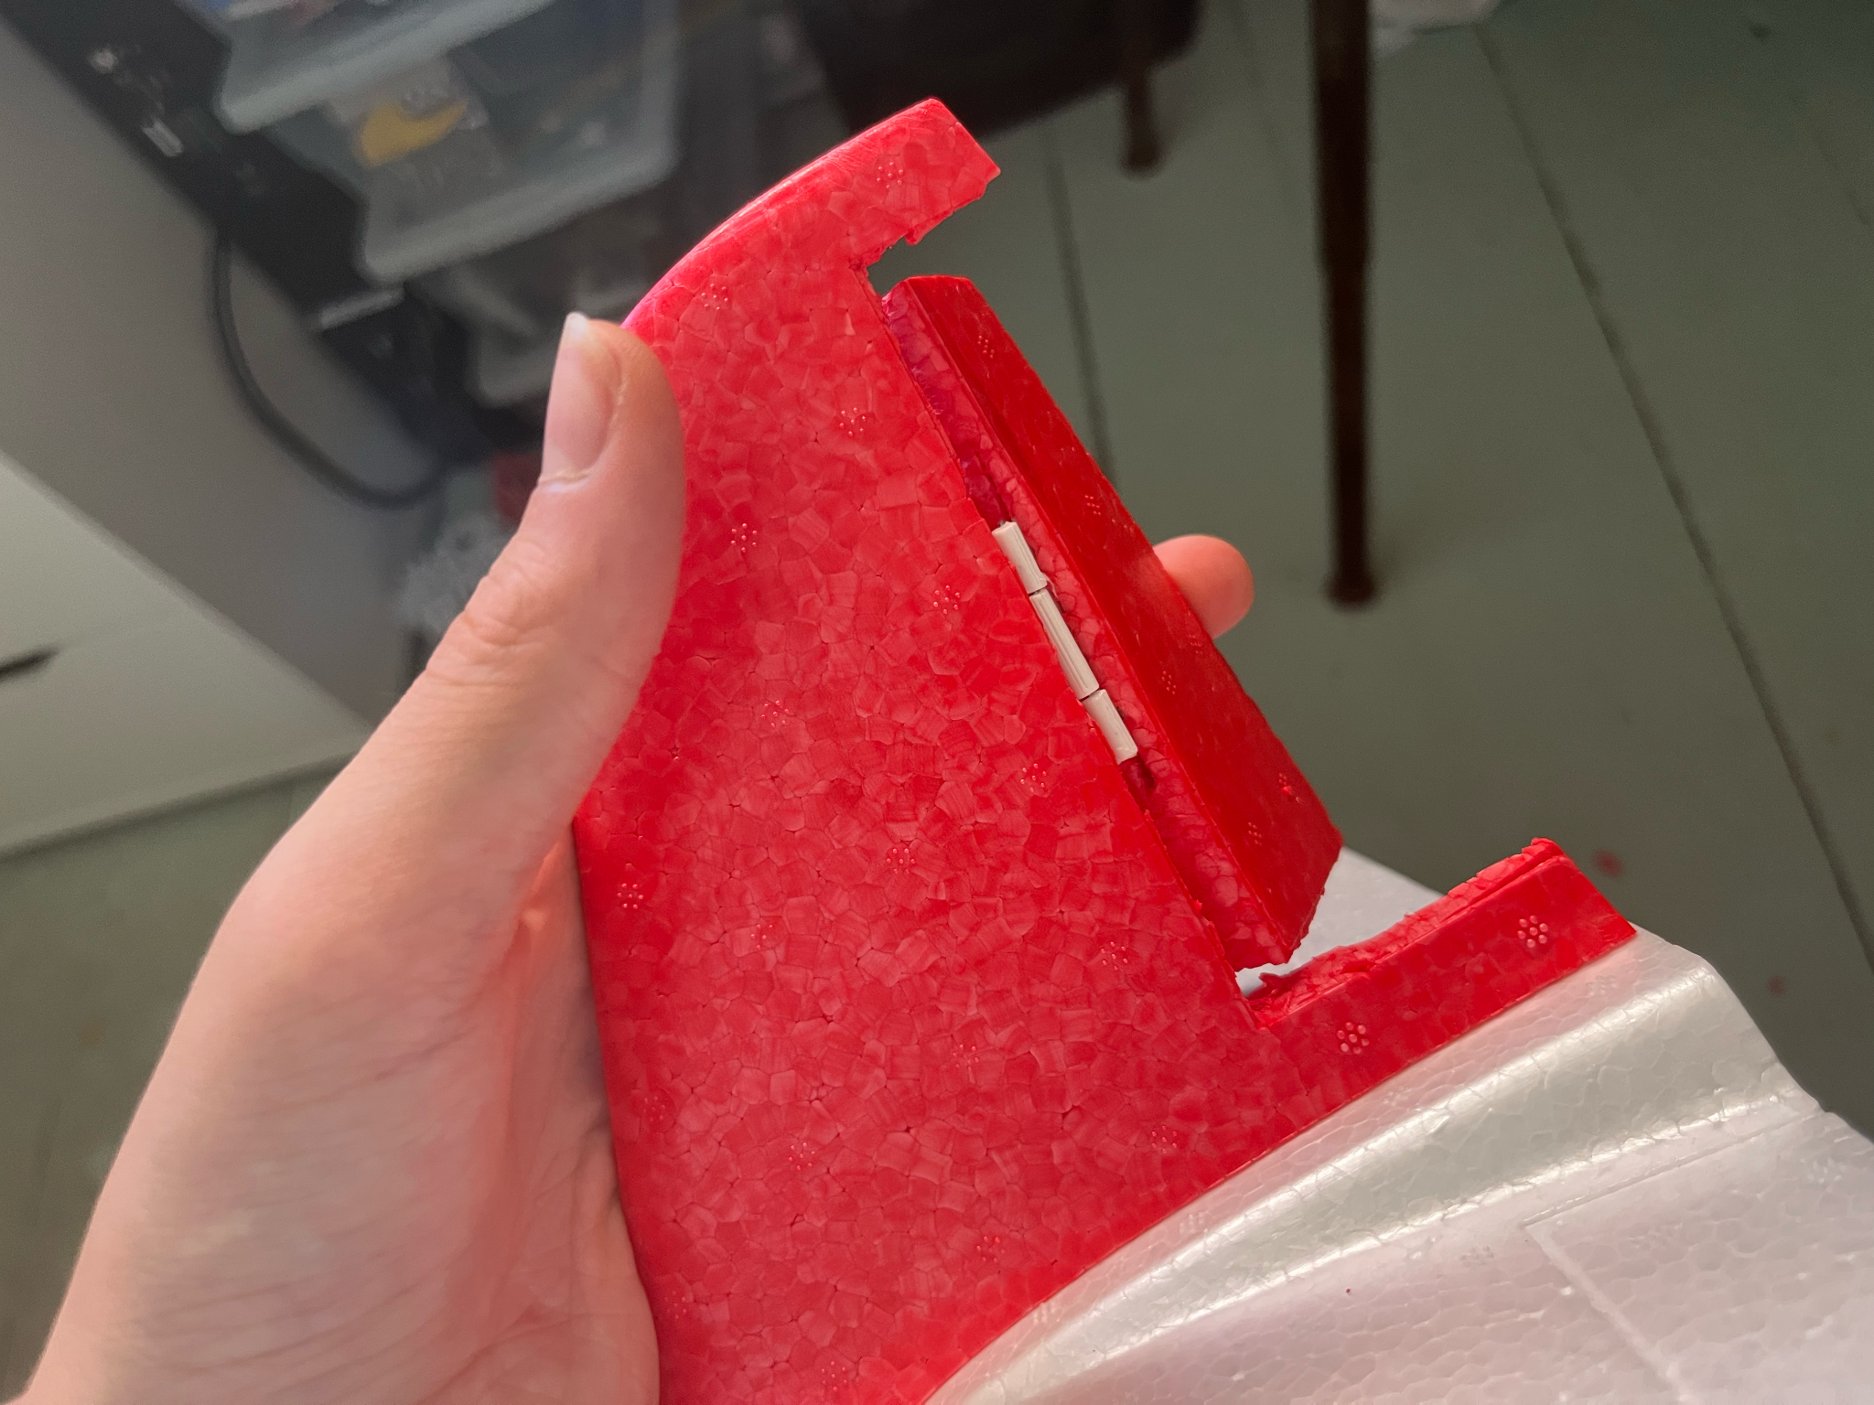
The Glider (Cont.)
Notes:
For steering, the glider uses a servo with a pushrod, connected to the rudder. The rudder is connected to the main body with a custom 3D-printed hinge.

Slide 8
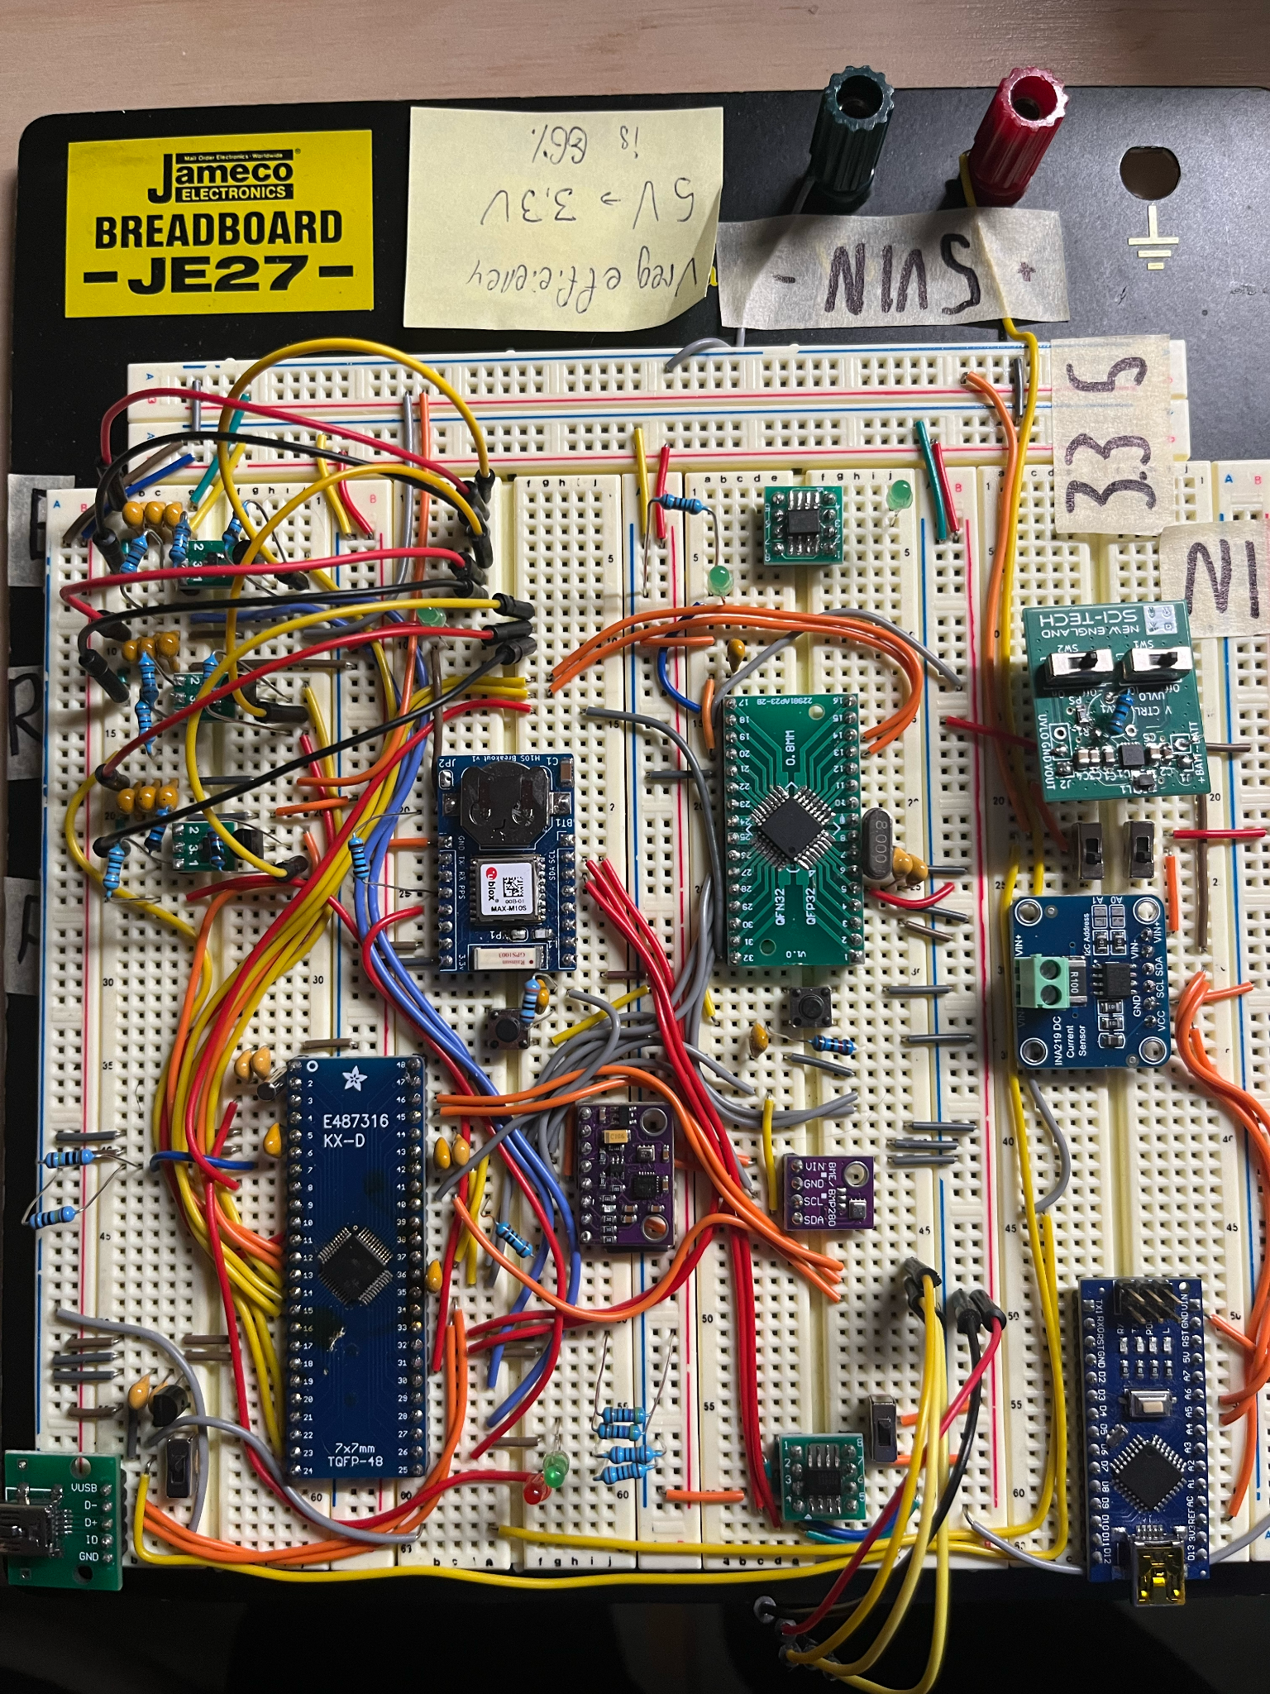
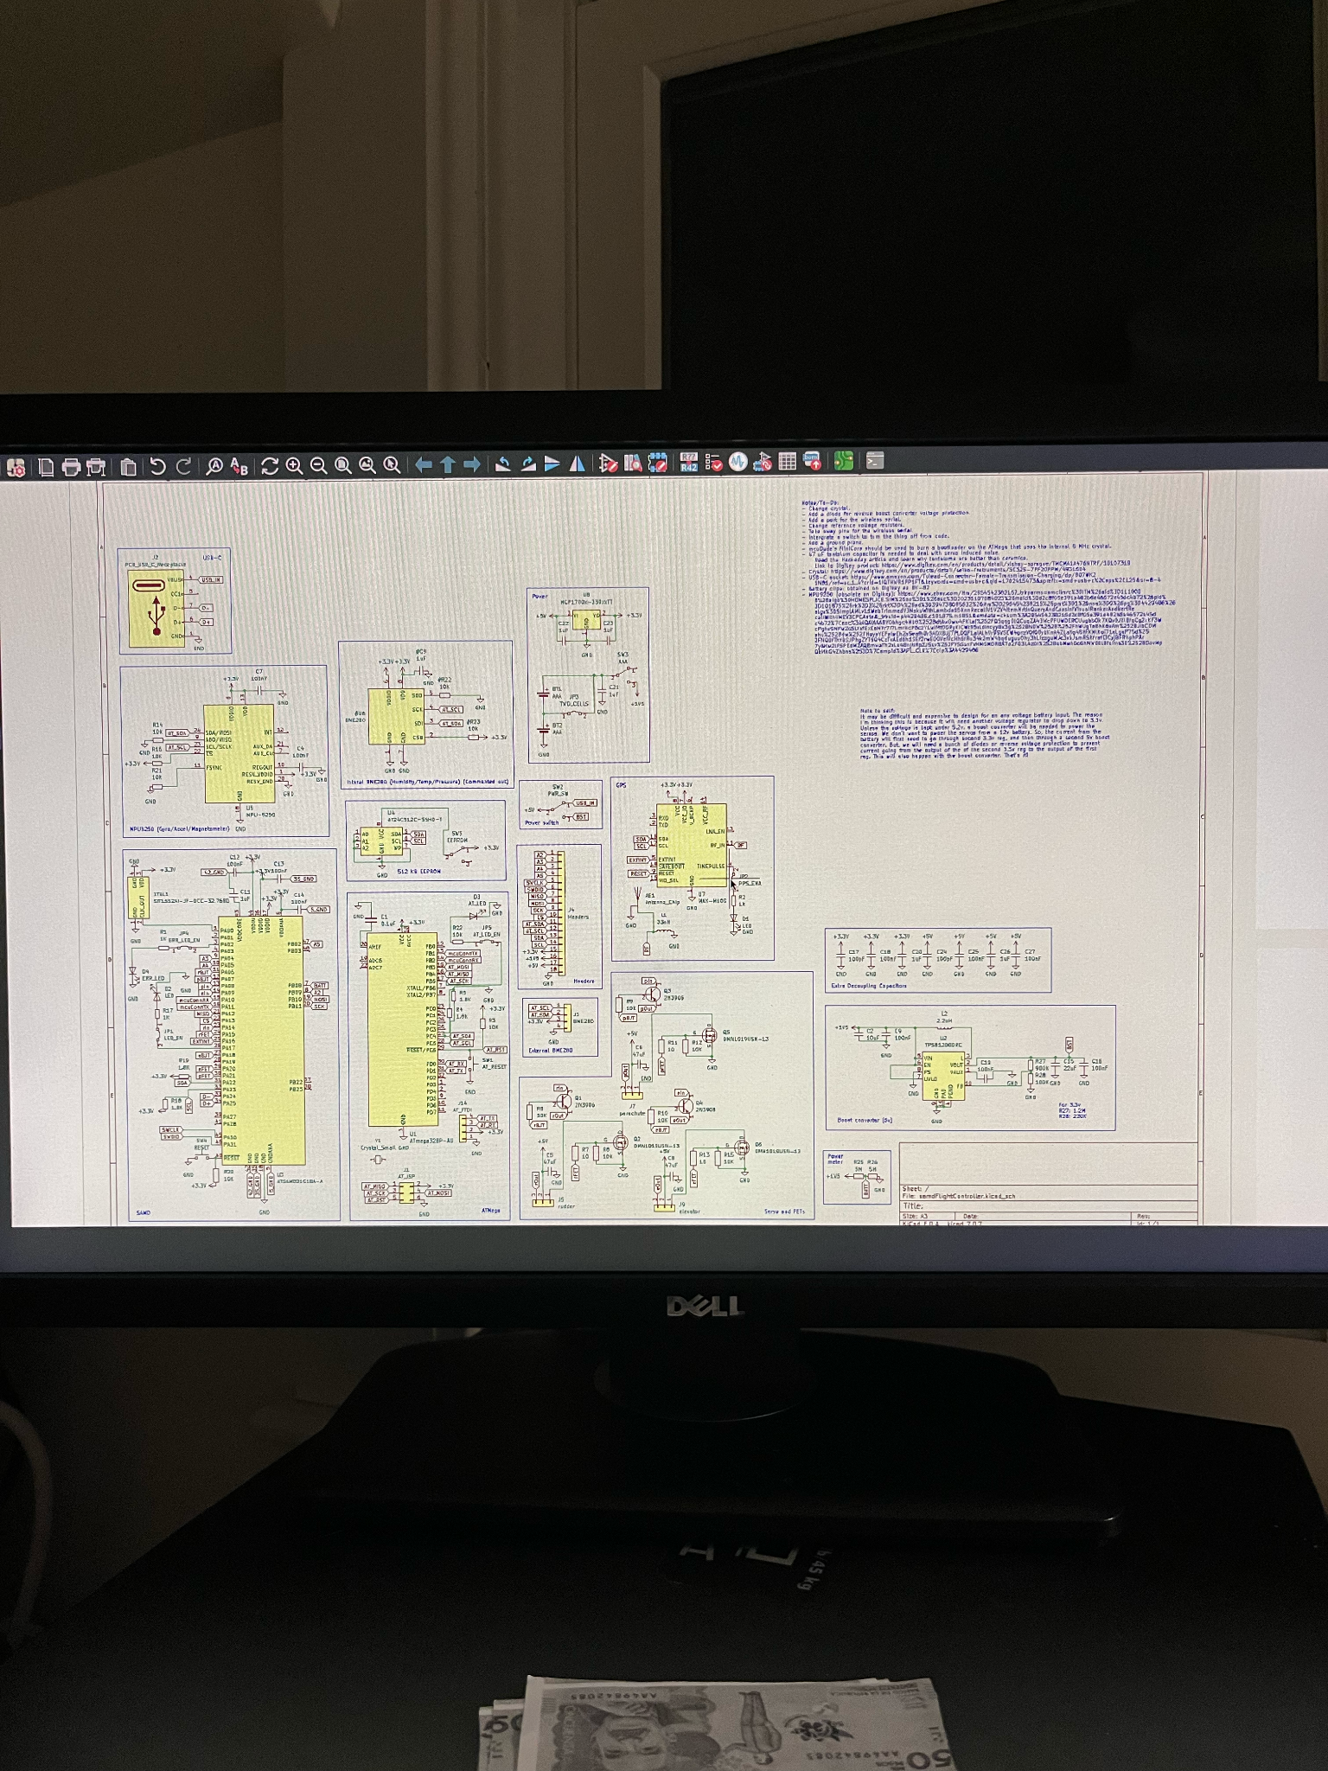
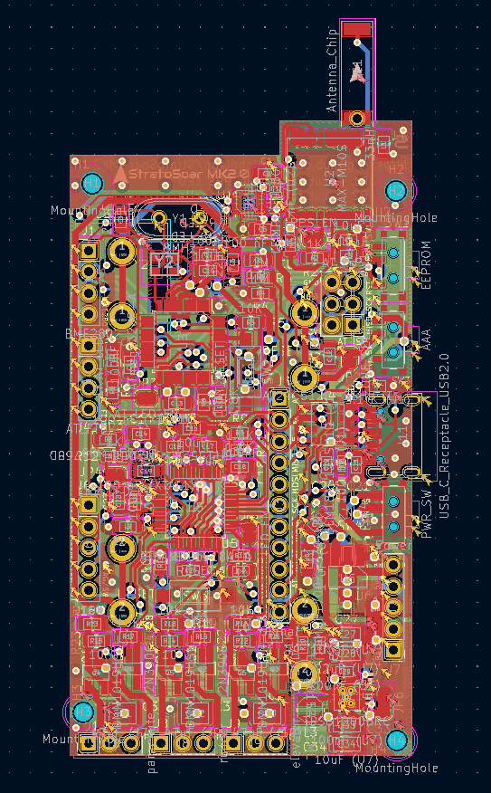
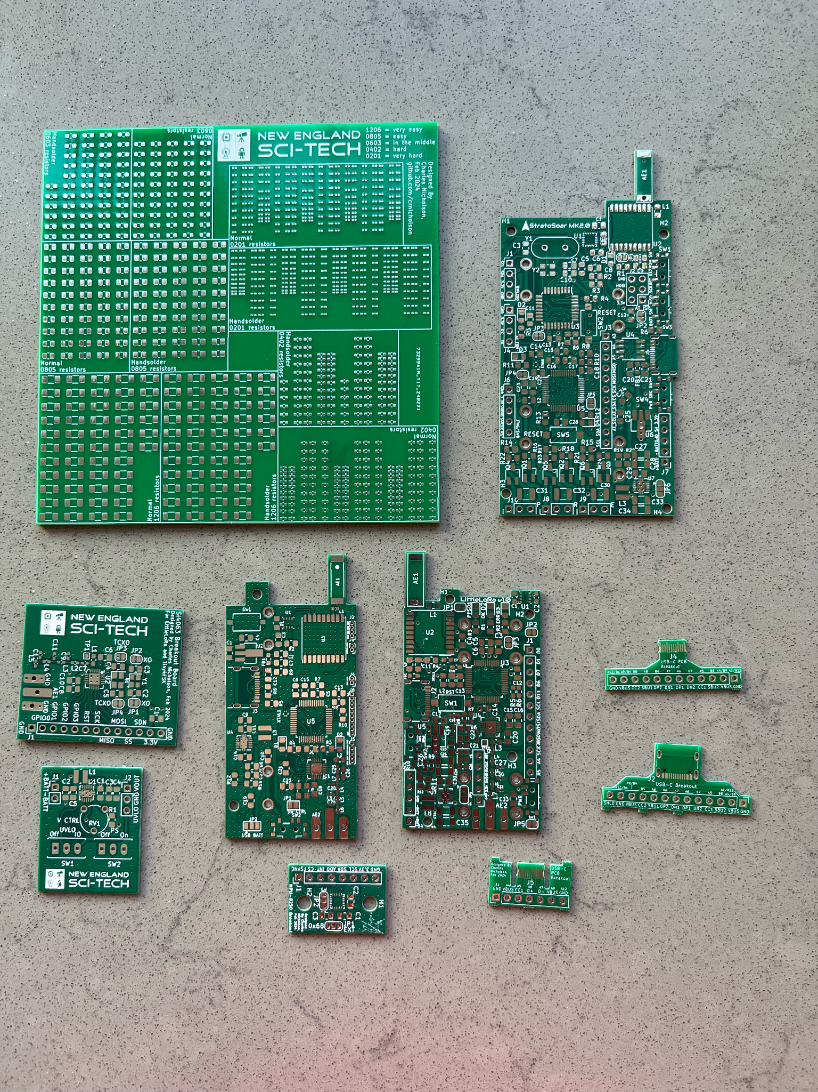
Electronics
1.
2.
Custom 4-layer PCB
150+ components
9 breakout boards
RF + power electronics
3 revisions
4.
3.
Notes:
The electronics is a custom 4-layer PCB with over 150 components, all hand assembled. It integrates an inertial measurement unit, or IMU, for pitch, yaw, and roll values. It uses MOSFETs to control power to the servo for lower power. The glider has a GPS for obtaining the current location. Additionally, we have two processors, one dedicated just to the IMU and one for general control. The board has had 3 versions and packs everything to boost converters to RF circuits.

Slide 9

Code + Function
Arduino C++
IMU input w/ Kalman filter
PID algorithm
Low power modes
Notes:
The program is written in Arduino C++, which then parses the raw values from the IMU and uses a Kalman filter to expose the pitch, yaw, and roll. The control is based on a combination of simple algorithms and a PID system to make robust and powerful autonomous flight. It also packs in some special features such as data recording to EEPROM and optimization for low power control, only consuming 50 mA.

Slide 10
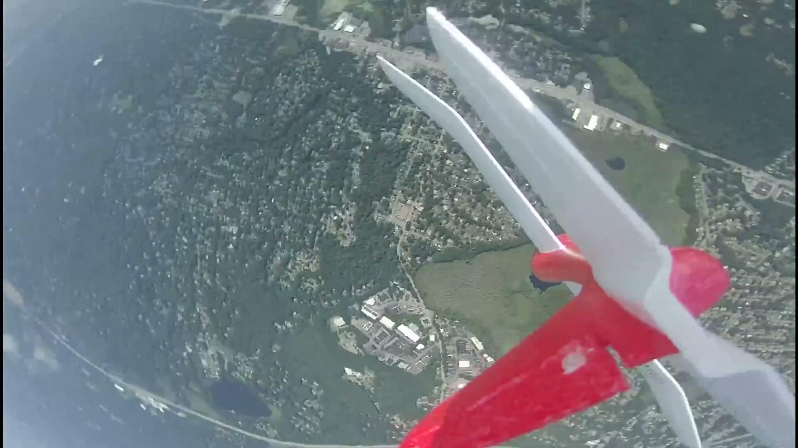
Results
Launched from 5,000 feet
Tracker overheated shorty after lift off
Flight was 66% shorter than expected
Glider found by homeowner
Notes:
This year, we successfully launched from 5,000 feet. However, the Tiny4FSK tracker had some last minute changes done that accidentally disconnected the antenna and caused the system to overheat. The glider had a much shorter flight than expected, landing close to an interstate! Thankfully, a homeowner found the glider and returned it to us, completely in shape and ready for data analysis.

Slide 11
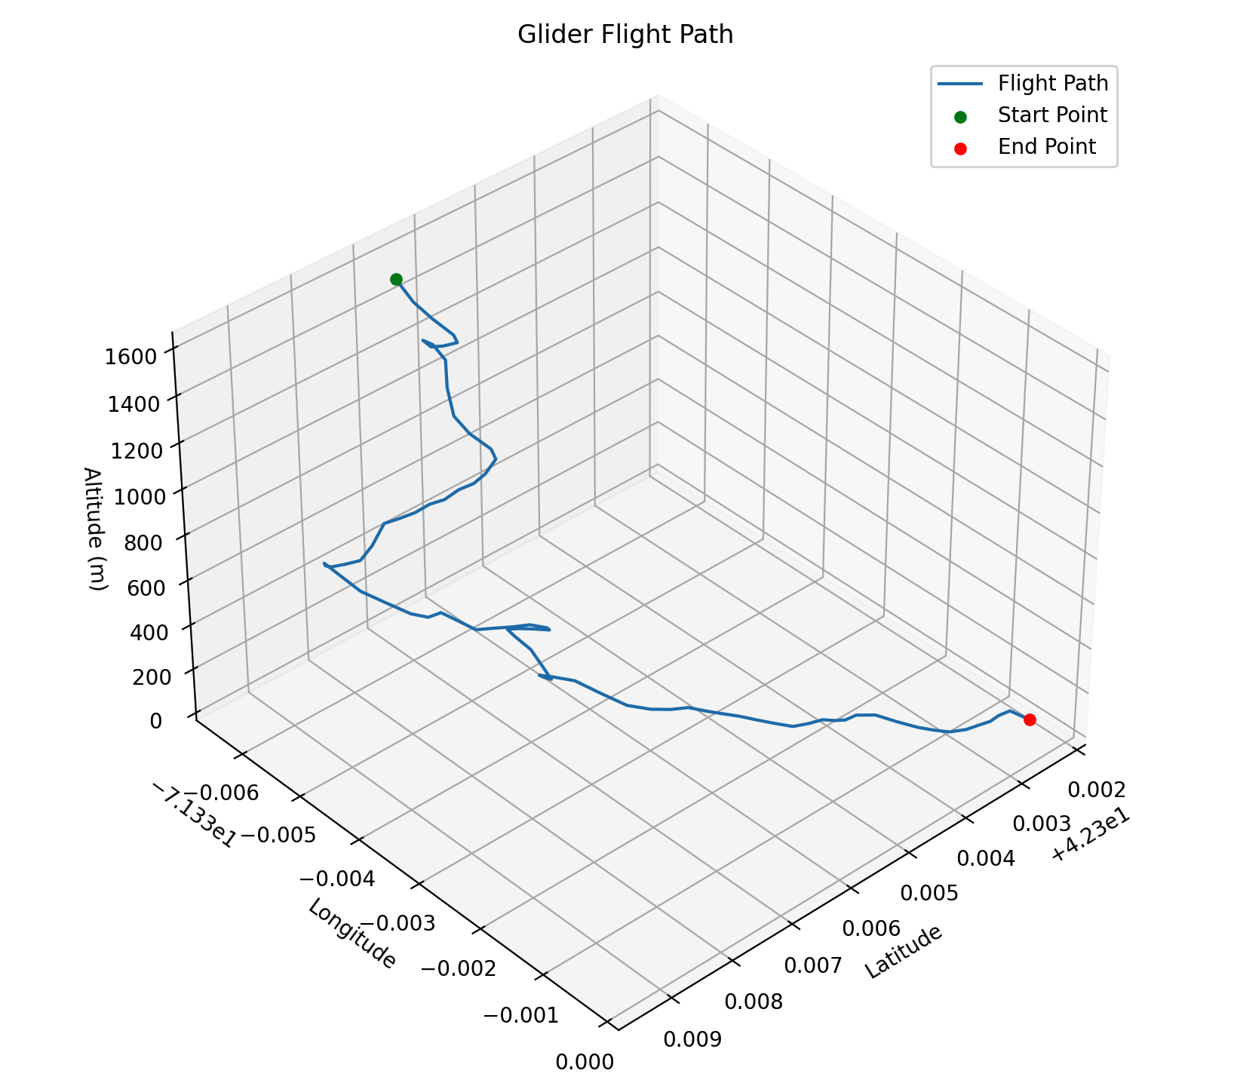
Results (Data)
Pitch, yaw, temperature, pressure, altitude, time recorded
Python used to recreate flight path
Flight KML generated
Glider flew ~1840 meters ground distance
Notes:
The data was recorded on the EEPROM as pitch, yaw, temperature, pressure, altitude, and time. Max and I used Python to convert all this values into coordinates given the starting latitude, longitude, and altitude. Additionally, we implemented data augmentation to direct the flight path to the actual landing coordinates to counteract errors in the data. We also wrote a program to export the plot as a KML file so we could view the flight path in Google Earth. We were able to determine the glider flew 1840 meters above ground and 2850 meters in 3D distance, only a 3rd of what hoped.

Slide 12
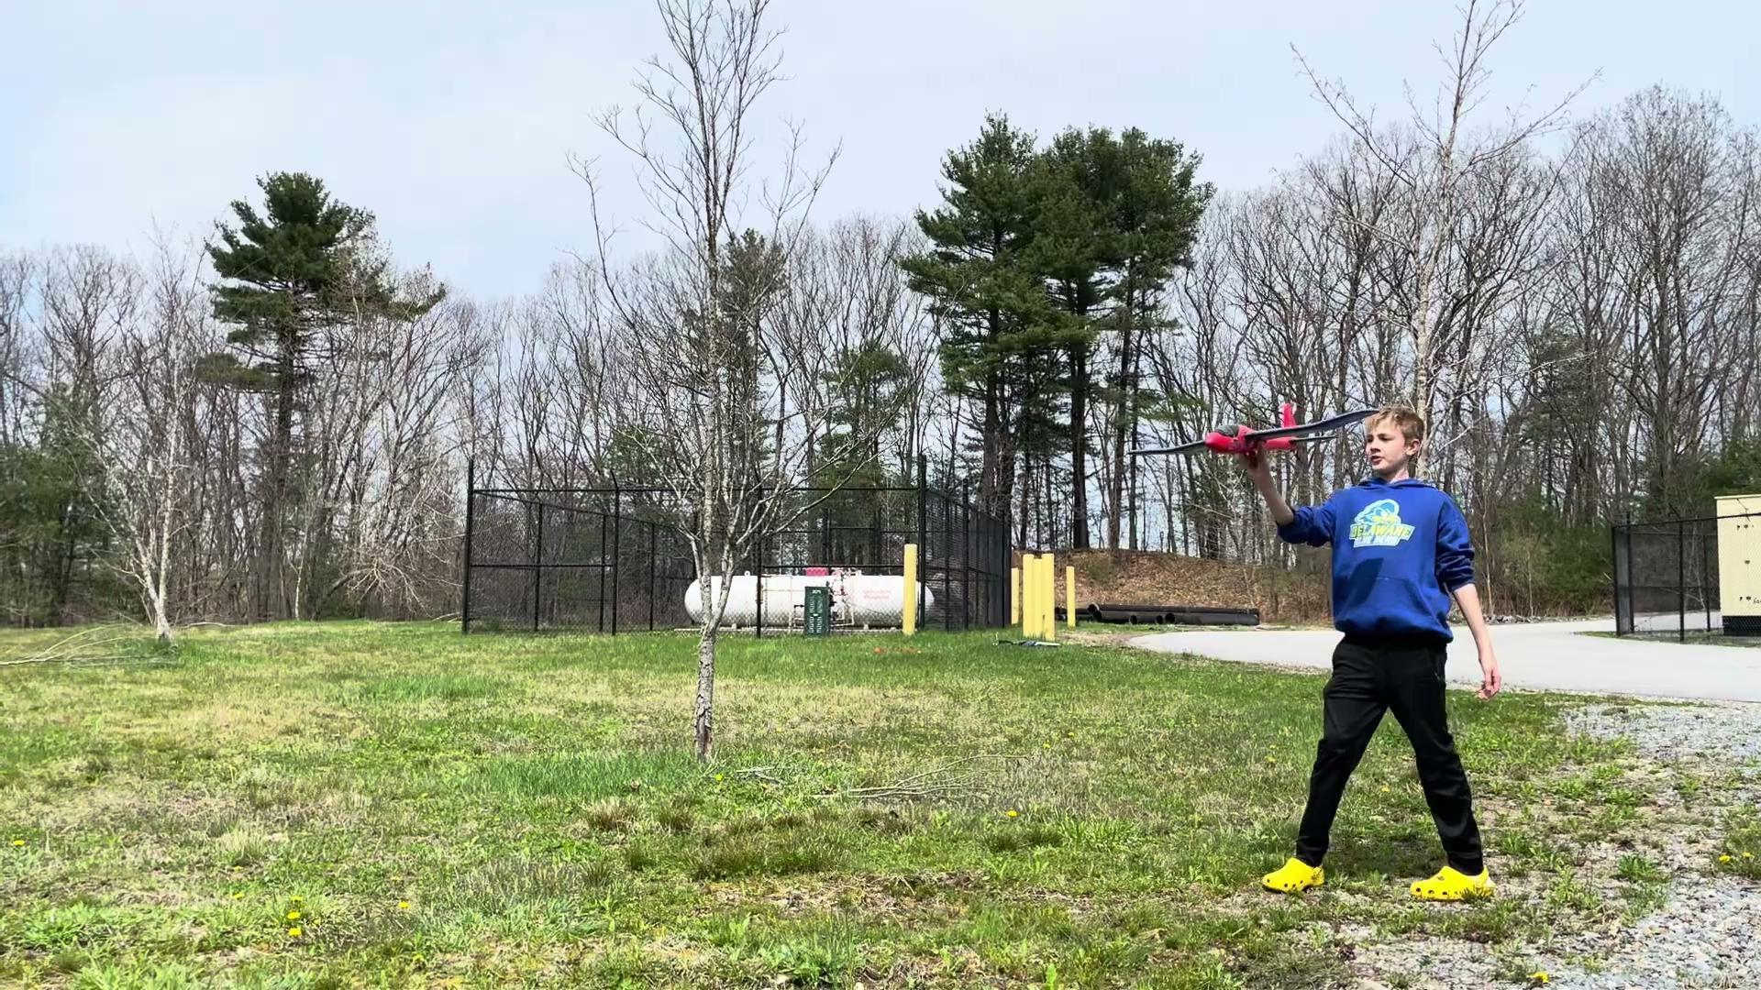
Results (Ground)
Field testing shows success
Glider can navigate autonomously to correct coordinates
10 hours battery life on 17 gram battery
Notes:
We also did some testing on the ground before the launch, and we were able to see that the glider navigate autonomously to correct coordinates, as shown in the video. We were also able to measure than the glider would last 10 hours on a 600 mAh battery, weighing in at 17 grams.

Slide 13
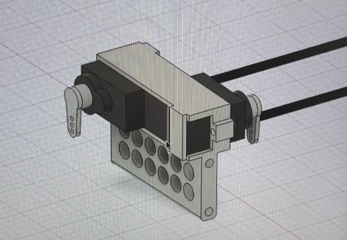
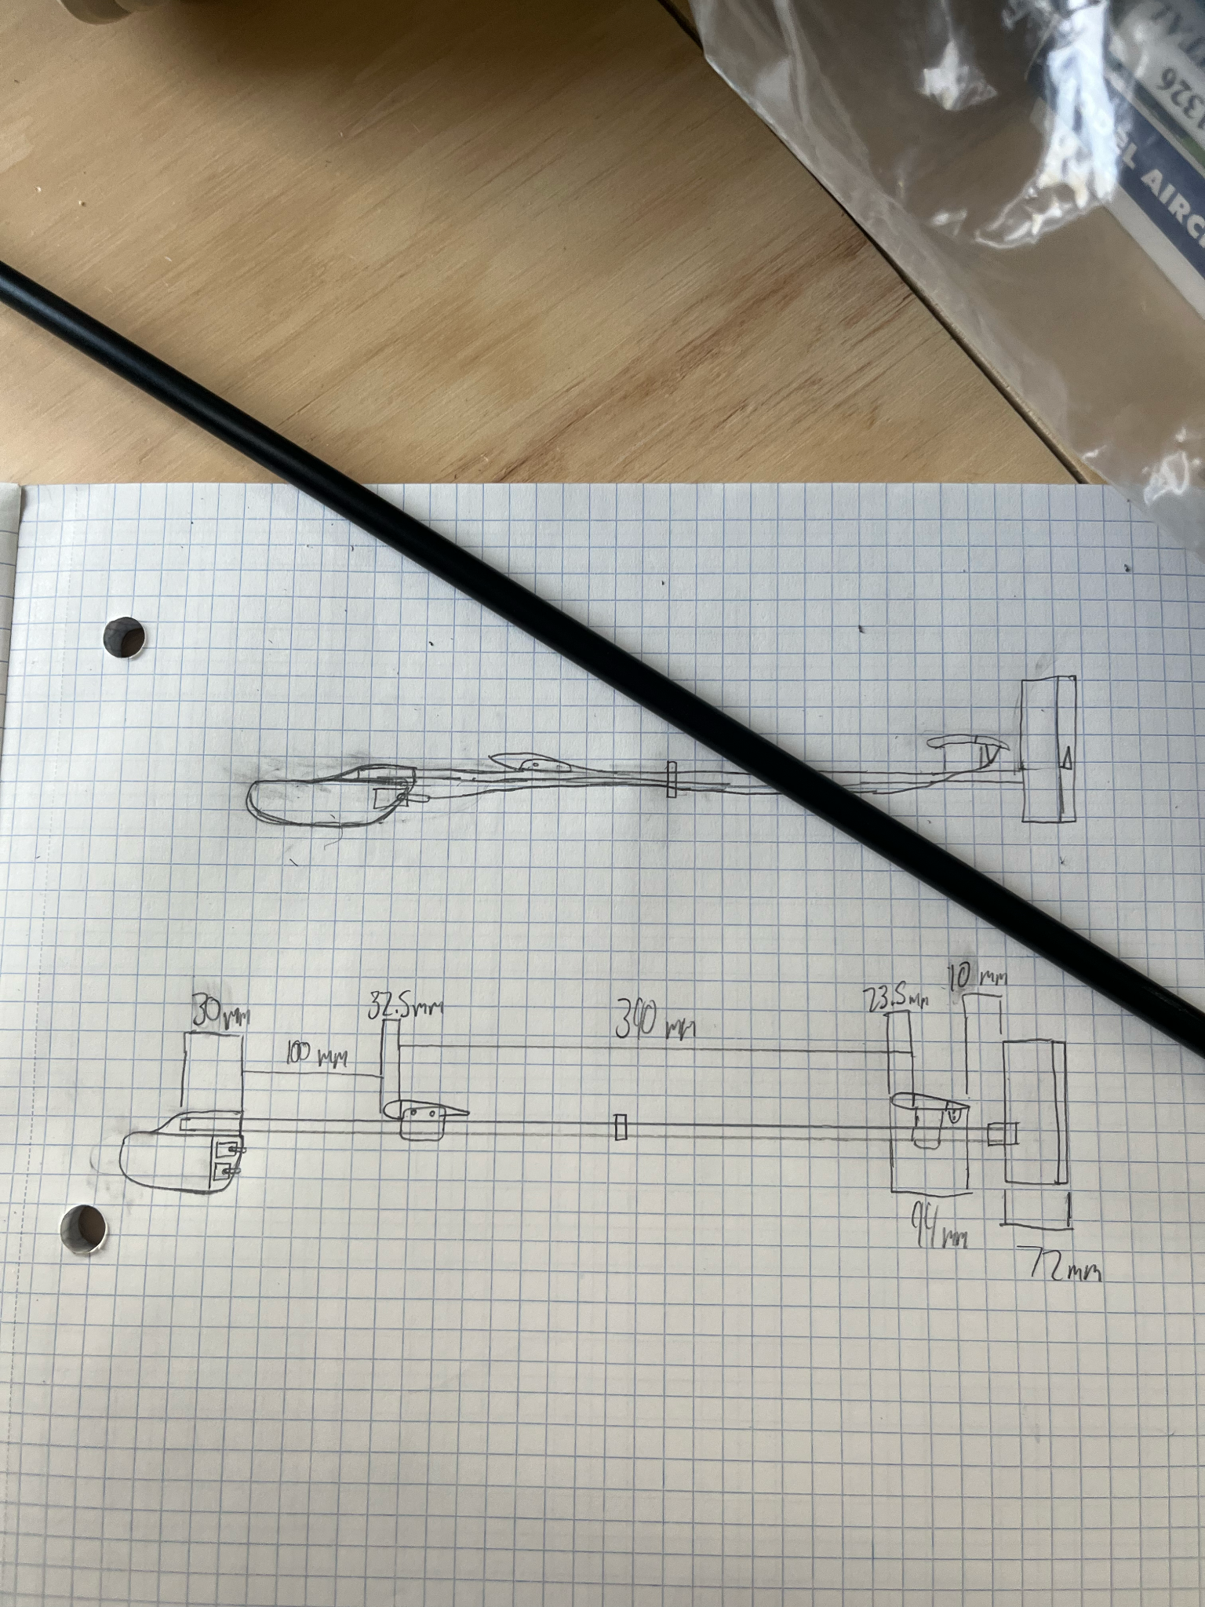
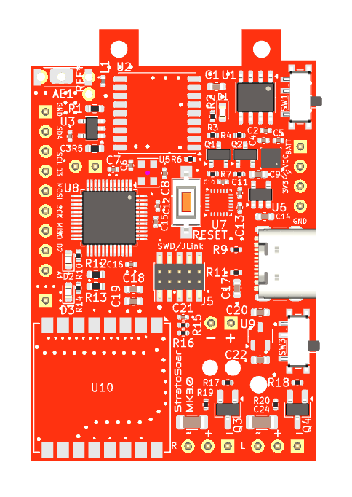
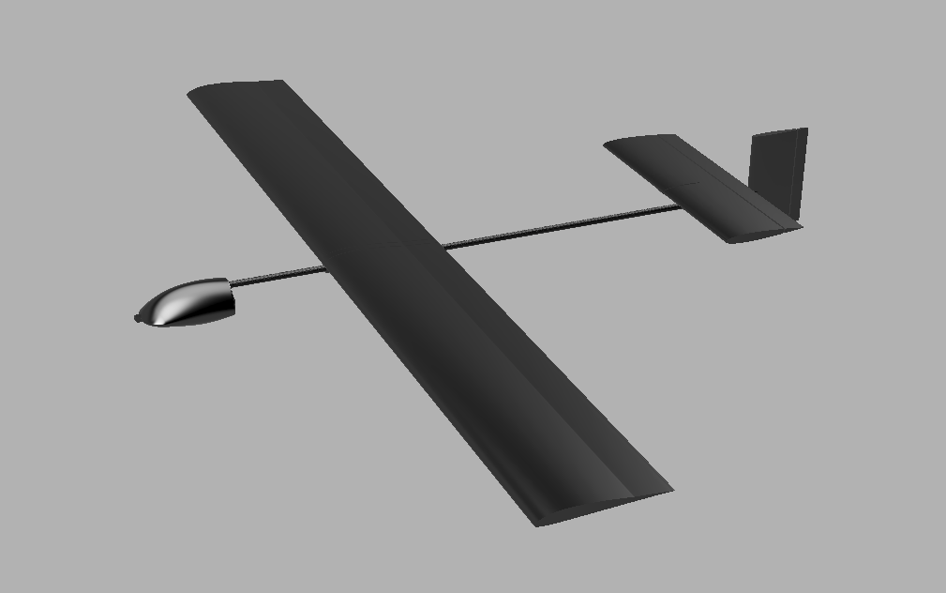
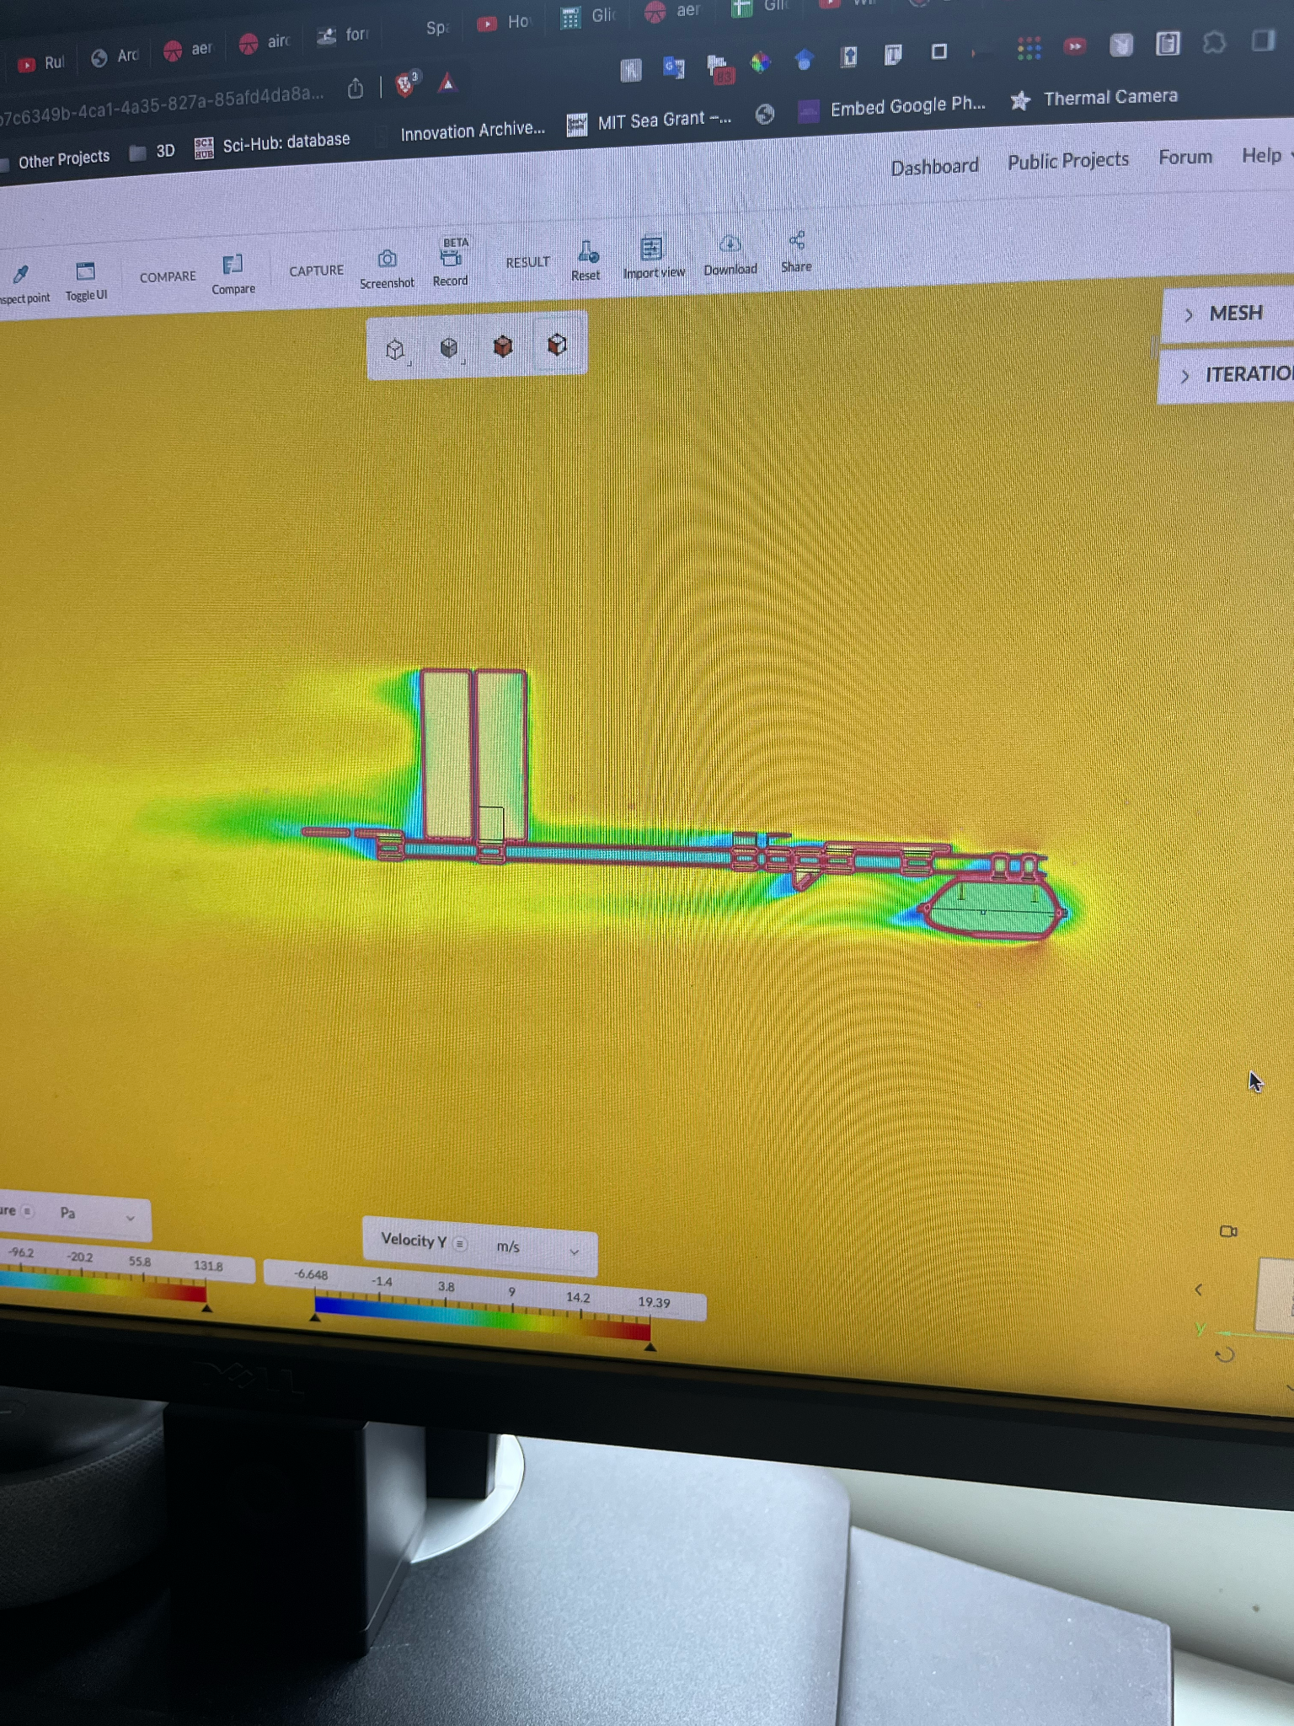

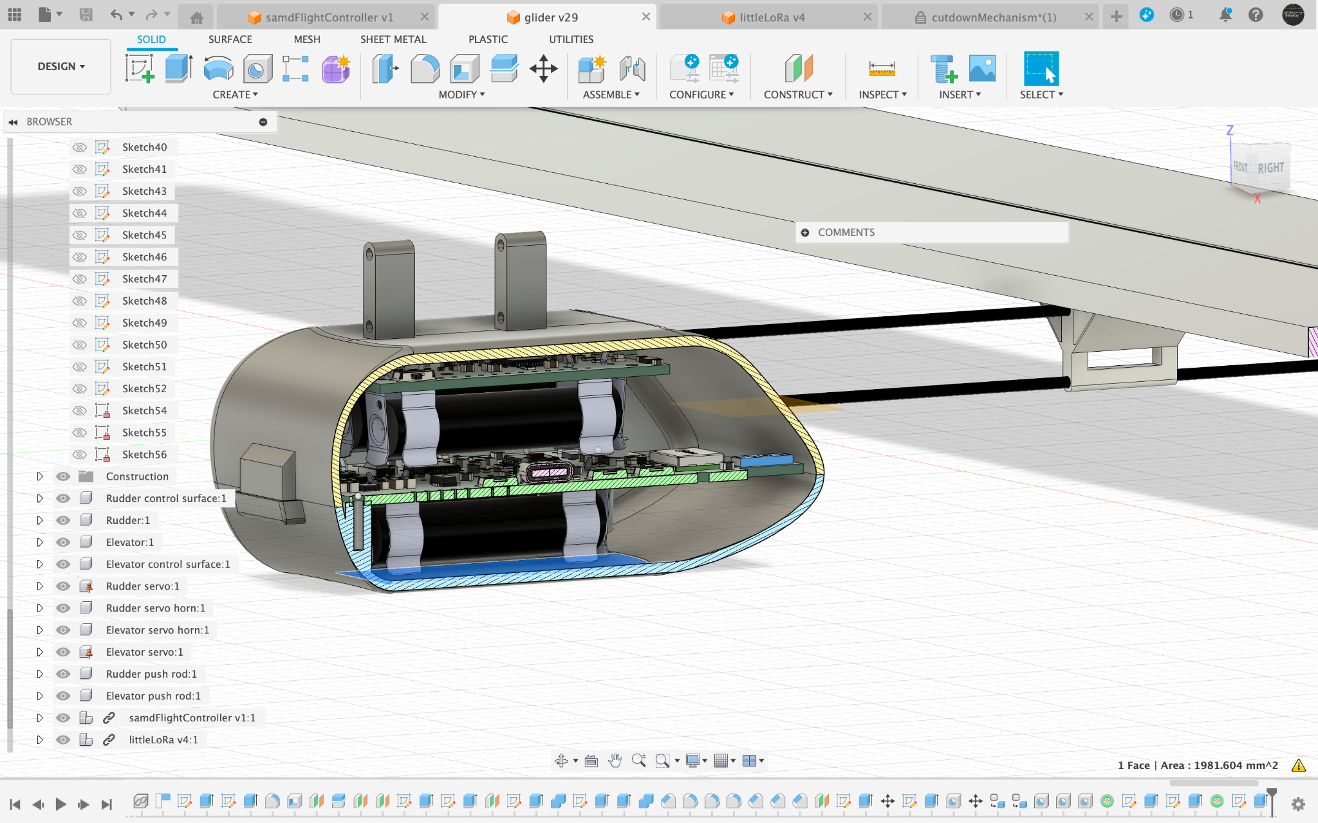
Next Steps
StratoSoar MK3
Custom flying wing glider
Custom high performance glider
Smaller electronics
Integrated tracking
Notes:
Note that this slide has a QR code to the link of the project GitHub and information. Next year, I want to revisit the project and redo the PCB to integrate a LoRa tracking system, reduce the number of components, reduce the price, reduce the size of the board, and allow for machine assembly. I am working on making a custom high performance glider with hot wire cut foam wings and a low-cost origami one. This will hopefully make the glider more accessible to everyone

Slide 14
Credits
Thanks to Max and Seth Kendall for all the help and making this possible.
Thanks to Mike Malis for help with the aerodynamics.
Thanks to Brett Miwa, Joe Fitzgerald, Mike Hojnowski, Mark Jessop, and all the other people at NEST and on the NEWBS Discord server.
Thanks to my parents for all the support.

Slide 15

Thank You for Listening!
Project page + GitHub: https://github.com/crnicholson/StratoSoar-MK2
Photos + videos: https://github.com/crnicholson/StratoSoar-MK2-Media
Email: charlienicholsonr@gmail.com
Notes:
You made it! Feel free to check out the first link, my GitHub repository, where you can find this presentation and all the data. If you want to see all of my photos and videos from testing and building, check out the second link! Lastly, since I am not available to present this today, please ask any questions over email!

Slide 16
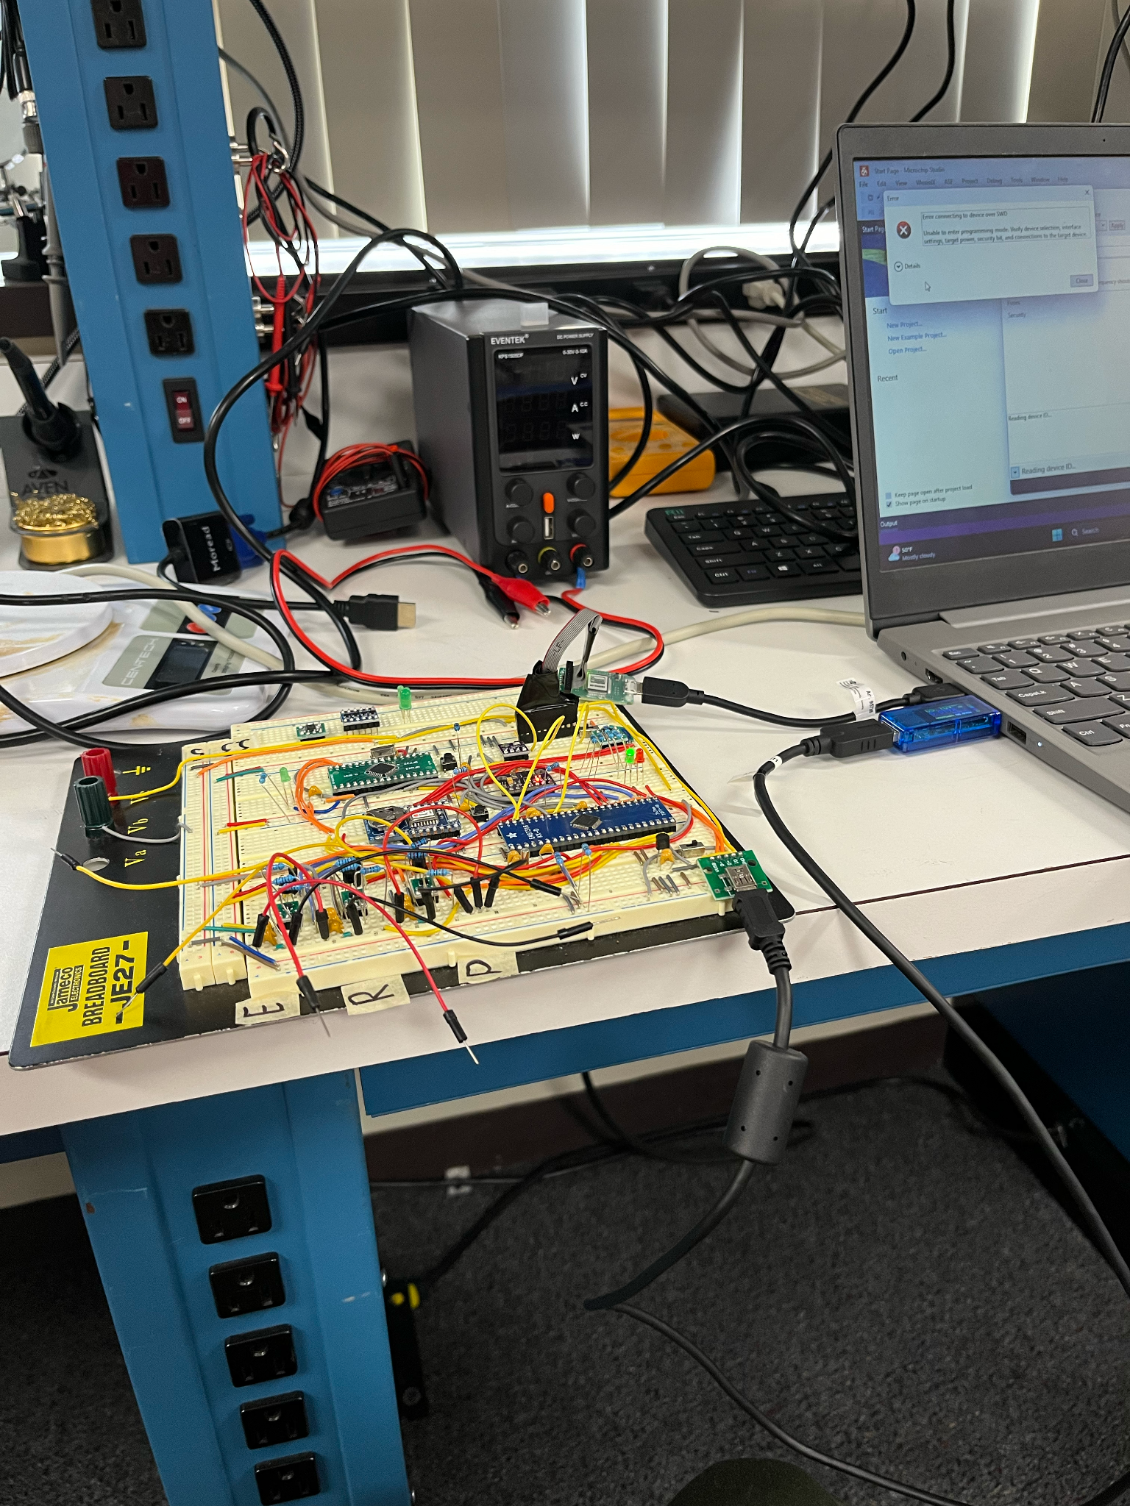
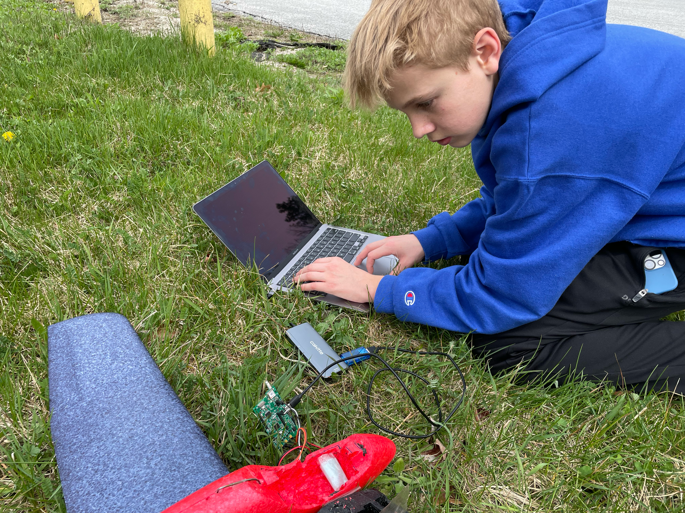
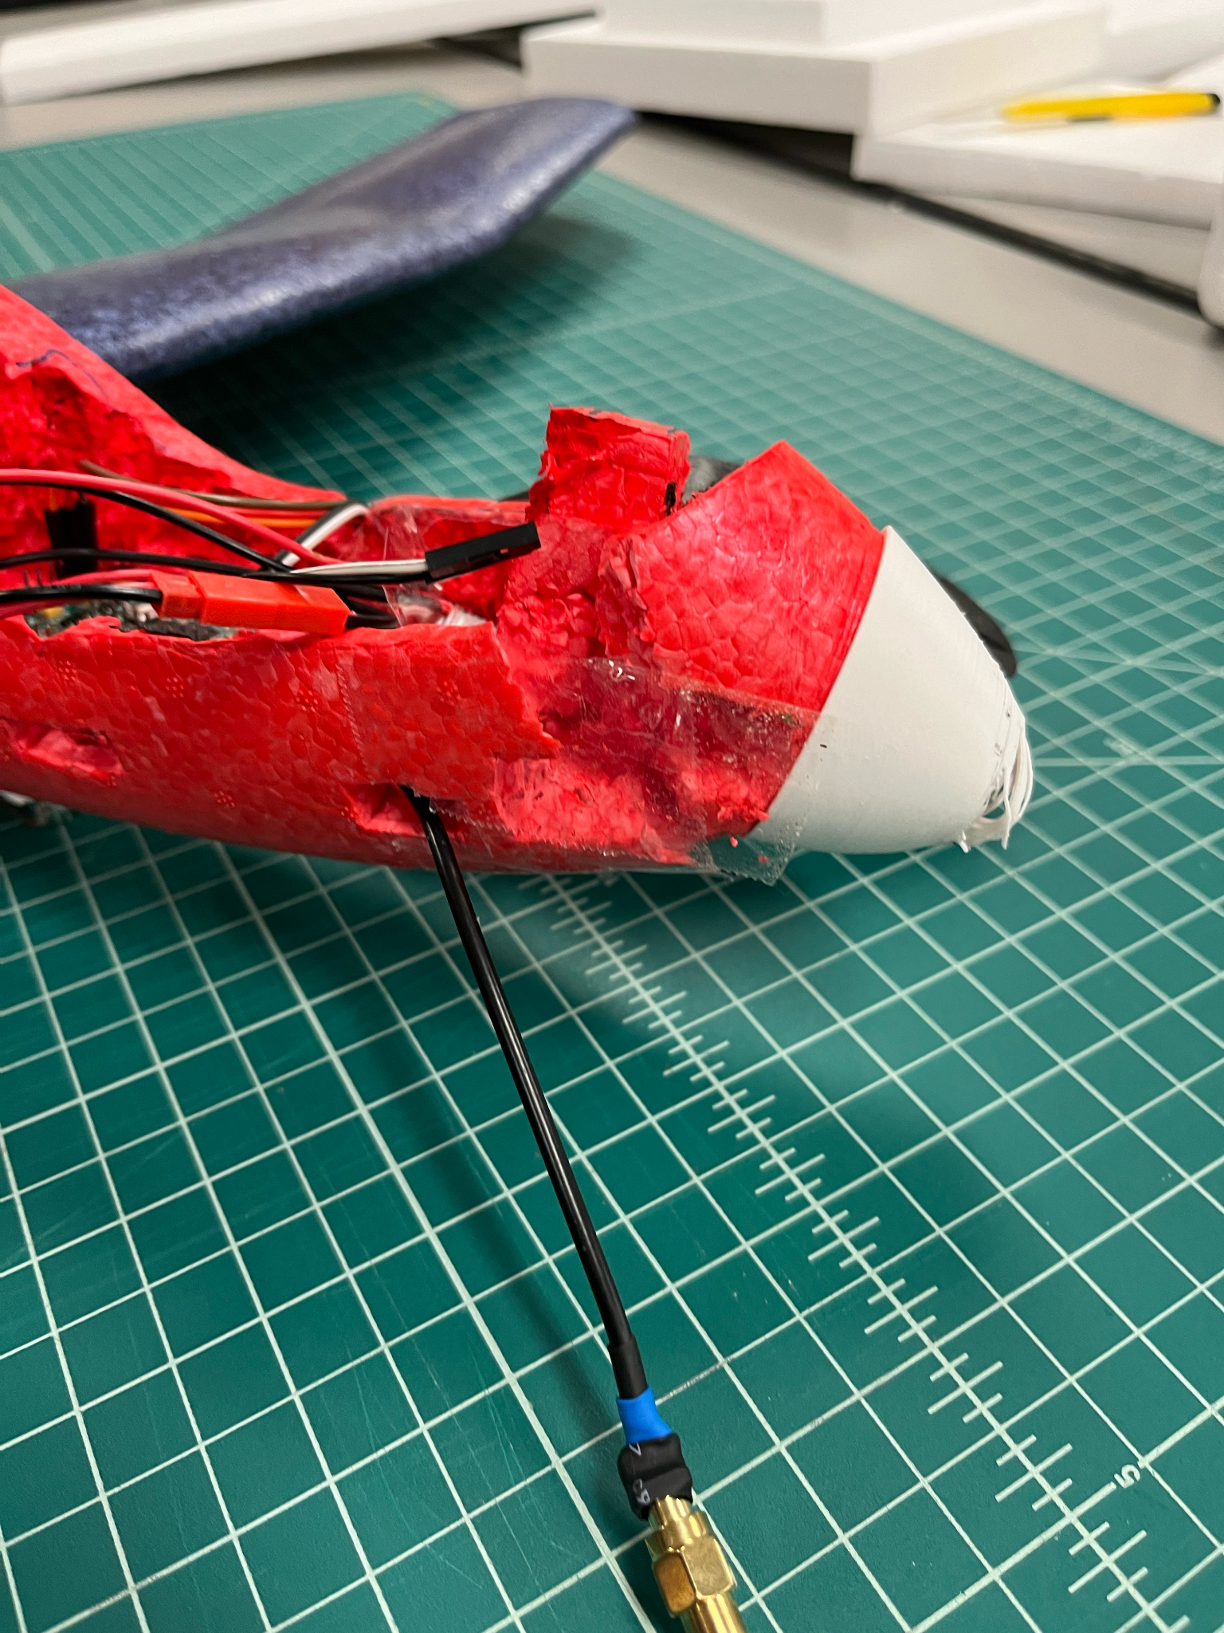
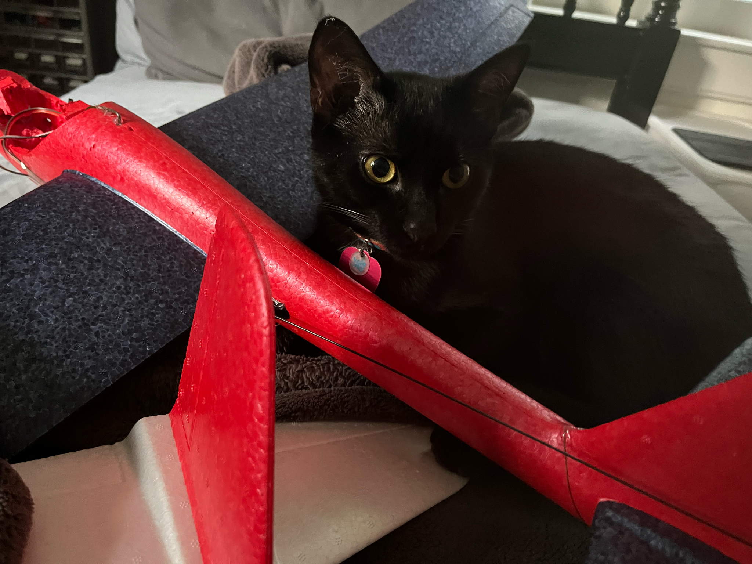
The Journey

Slide 17

Legal Shmeegle
Glider is free flight glider
Loophole means little restrictions from FAA
However, tracker is not FCC approved
Notes:
I’ve had a long email chain with the FAA, and we’ve found a way to do my experiments legally. Since the glider

